Slide 1
Full-Waveform adjoint moment tensor inversion
Azhar Harisandi - 22320011
Pembimbing :
Dr. rer. nat. David P. Sahara
Dr. rer. nat. Andri Hendriyana
Faculty of Mining and Petroleum Engineering
Department of Geophysical Engineering

Slide 2



Case 1
 | starting | “True” model | Inverted
Strike | 90 / 0 | 110 / 17.25 | 110 / 17.34
Dip | 90 / 90 | 78 / 77.3 | 78 / 77.37
Rake | 0 / 180 | 13 / 167.7 | 12.9 / 167.7
Mw | 2 | 1.8 | 1.8
2.30E-09
5.32E-10
1.20E-10
4.76E-11
2.02E-11
1.12E-11

Slide 3
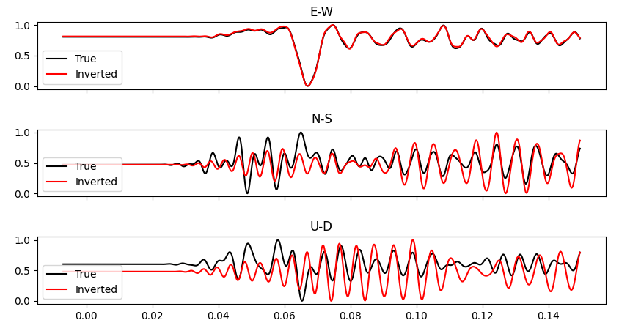
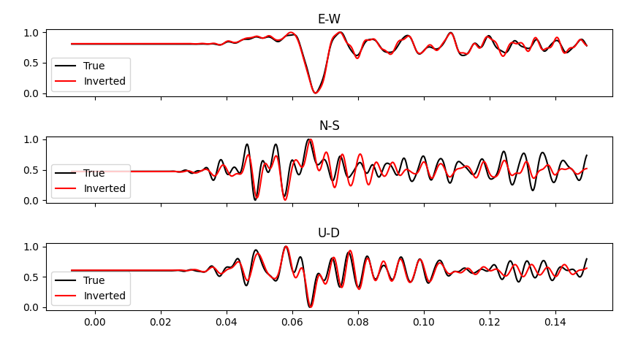
Waveform using initial model
Waveform using inverted model

Slide 4


Case 2
 | Starting | “True” model | inverted
Strike | 130 / 20.3 | 110 / 17.25 | 110 / 17.31
Dip | 40 / 74.2 | 78 / 77.3 | 78.06 / 77.34
Rake | 25 / 127.25 | 13 / 167.7 | 12.93 / 167.76
Mw | 1 | 1.8 | 1.8

Slide 5
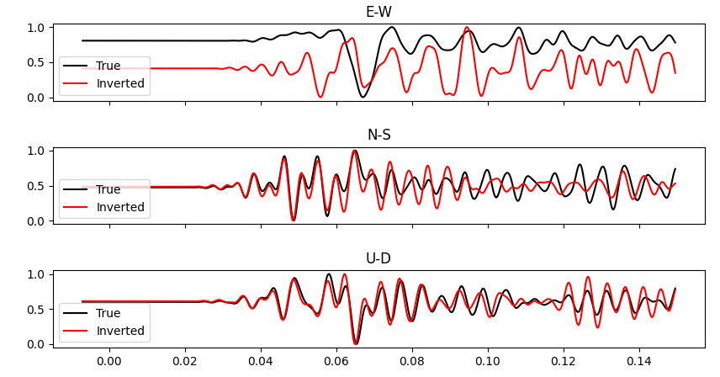
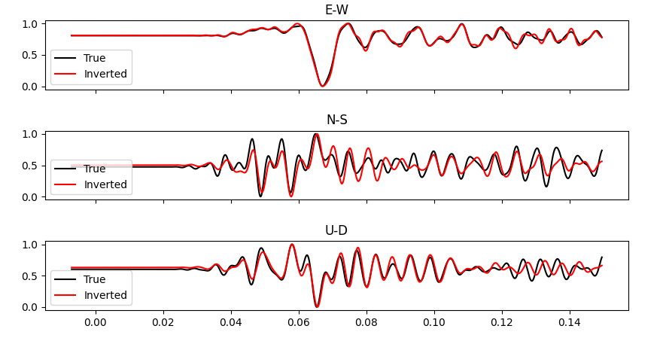
Waveform using initial model
Waveform using inverted model

